Slide 1
45 Day Check-in and Preparing for Budget Development
GO Team Meetings #3 and #4
Ralph J. Bunche Middle School
December 4, 2023
5:00 PM

Slide 2
AGENDA
Ralph J. Bunche Middle School
December 4, 2023
5:00 until 7:00 PM
Location: Zoom*
Call to Order
Roll Call; Establish Quorum
Action Items
Approval of Agenda
Approval of Previous Minutes
Elect new GO Team Parent Member
Discussion Items
45-Day Continuous Improvement Plan Check-in
Fall to Winter MAP Data
Review ofStrategic Plan and Continuous Improvement Plan Progress
Strategic Plan Update
Action Items as a result of Discussion
Approve Strategic Plan
Ranking Strategic Plan Priorities
Information Items
Principal’s Report
Announcements
Public Comment
Adjournment
2

Slide 3
Timeline for GO Teams
You are HERE
Fall 2021
GO Team Developed 2021-2025 Strategic Plan
1
Summer 2023
School Leadership completed Needs Assessment and defined overarching needs for SY23-24
2
August 2023
School Leadership completed 2023-2024 Continuous Improvement Plan
3
Sept. – Dec. 2023
Utilizing current data, the GO Team will review & possibly update the school strategic priorities and plan
4
Before Winter Break
GO Team will take action (vote) on the school’s strategic plan and vote on the ranked strategic plan priorities for SY24-25 budget discussions.
5
1
2
3
4
5

Slide 4
Data Discussion

Slide 5
Continuous Improvement goals
Literacy Goal:
To increase the number of full academic year students scoring proficient or above on the 2024 ELA GMAS, by 5% (from 18.5% to 23.5%)
Numeracy Goal:
To increase the number of full academic year students scoring proficient or above on the 2024 math GMAS, by 5% (from 11.3% to 16.3%)
Whole Child Intervention:
To decrease the school suspension rate from 2.39% to 1.3%

Slide 6
Continuous Improvement Plan: Quarterly CIP Check-in
As part of the Continuous Improvement process, all APS schools are completing a quarterly check-in for the Continuous Improvement Plans.
Click on the link below to review the quarterly check-in that was already completed for Ralph J. Bunche MS
https://apsstudents-my.sharepoint.com/:w:/r/personal/kimberly_whitfiel_apsk12_org/Documents/CIPchecks/BMS%20Oct%2023Quarterly%20Check-in%20Template.docx?d=w07a5e7142d5a46adaa1d06f8180e6883&csf=1&web=1&e=V81bTA
Questions to Consider
Based on our year long CIP plan, what are the actions that the school has already completed?​
What data supports the completion of an action step and success criteria (both implementation and student achievement)?

Slide 7
Discussion: Data Protocol
What do you notice?
What are your wonderings?
What additional questions do you have?

Slide 8
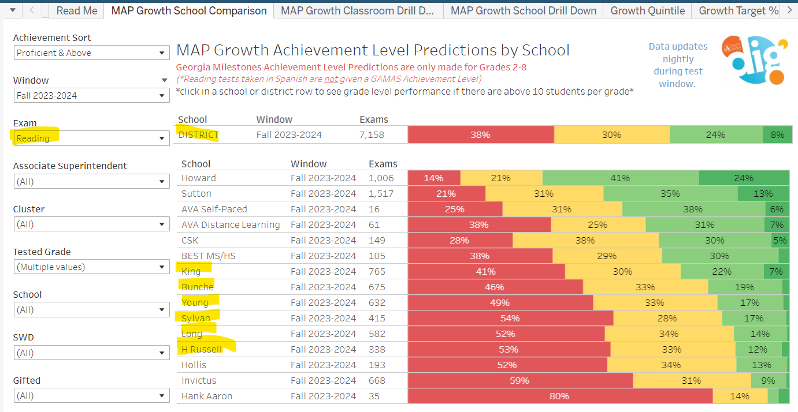
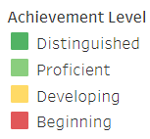
Fall 2023 MAP Results: Reading
Bunche Middle School
21%= Proficient & Above
Distinguished= 2%
Proficient= 19%
Developing=33%
Beginning= 46%
Literacy Goal to grow by 5% (from 18.5% to 23.5%)
Next Steps:
S2→ Identify students and provide specific support, small group instruction, remediation & reteaching, SDI, continue to monitor instruction, lesson planning, internalization

Slide 9
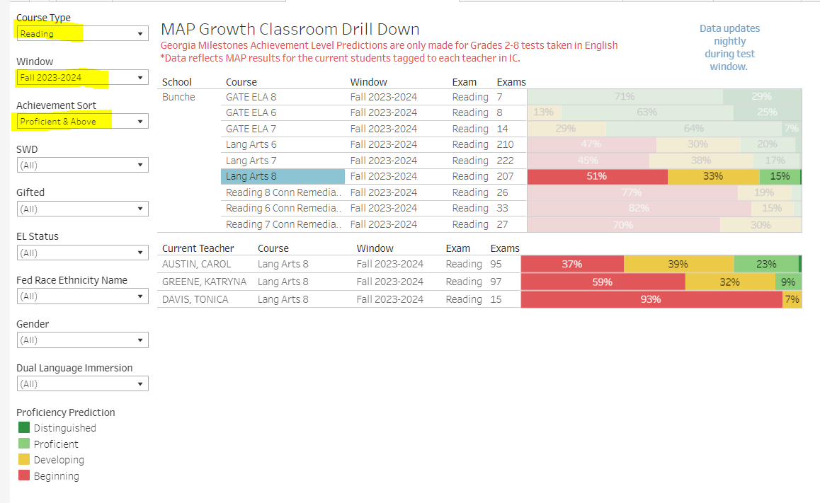
Fall 2023 MAP Results: READING
Bunche Middle School
21%= Proficient & Above
Distinguished= 2%
Proficient= 19%
Developing=33%
Beginning= 46%
Next Steps:
S2→ Identify students and provide specific support, small group instruction, remediation & reteaching, SDI, continue to monitor instruction, lesson planning, internalization

Slide 10
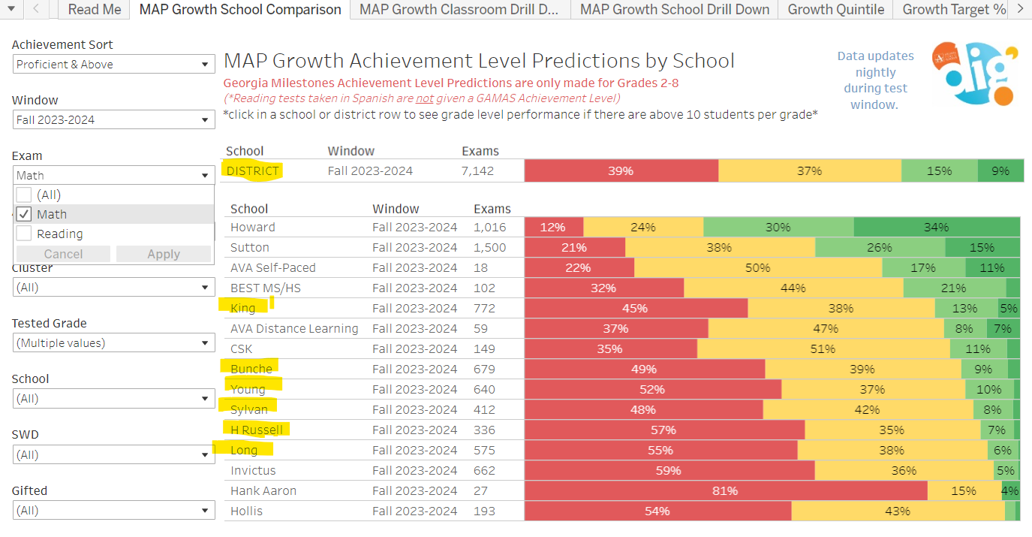
Fall 2023 MAP Results: MATH
Bunche Middle School
12%= Proficient & Above
Distinguished=3%
Proficient=9%
Developing=39%
Beginning= 49%
Numeracy Goal to grow from 11.3% to 16.3%
Next Steps:
S2→ Implement GADOE math standards and resources to support Amplify Math

Slide 11
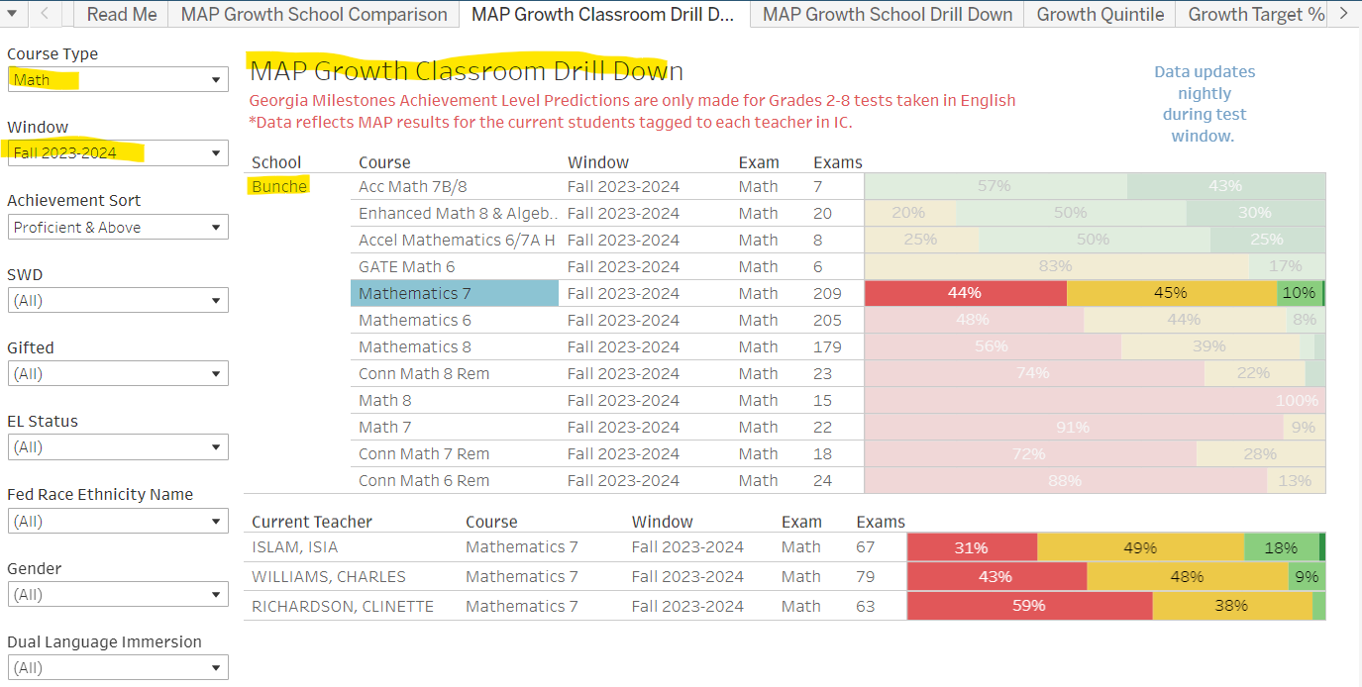
Fall 2023 MAP Results: MATH
Bunche Middle School
12%= Proficient & Above
Distinguished=3%
Proficient=9%
Developing=39%
Beginning= 49%
Next Steps:
S2→ Identify students and provide specific support, small group instruction, remediation & reteaching, SDI, continue to monitor instruction and lesson planning, internalization
Small group

Slide 12
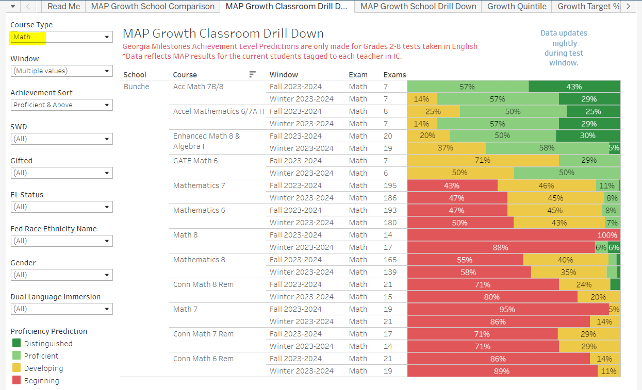
Fall/Winter 2023 MAP Results: MATH
Numeracy Goal to grow from 11.3% to 16.3%
WINTER
Proficient & Above= 11%
Fall Proficient &
Above = 12%
Small group
Small group

Slide 13
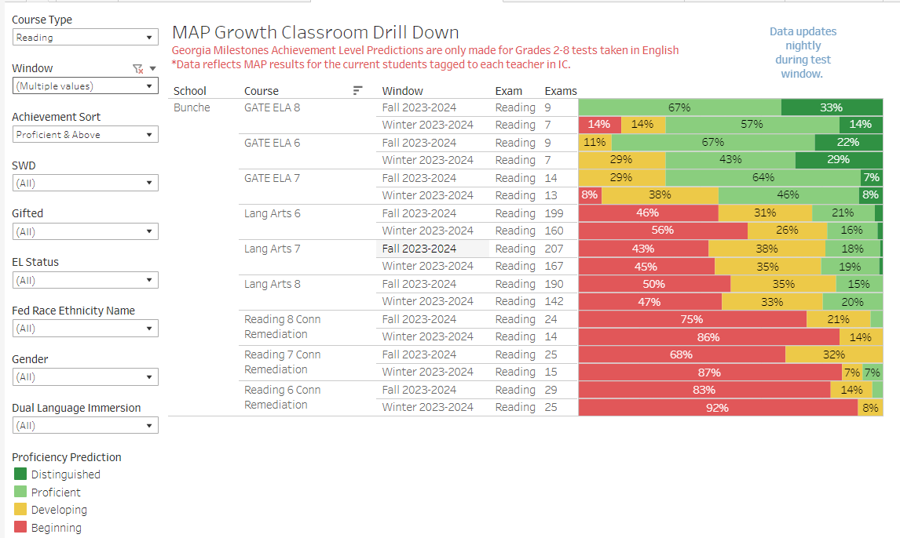
FALL/Winter 2023 MAP Results: READING

Slide 14
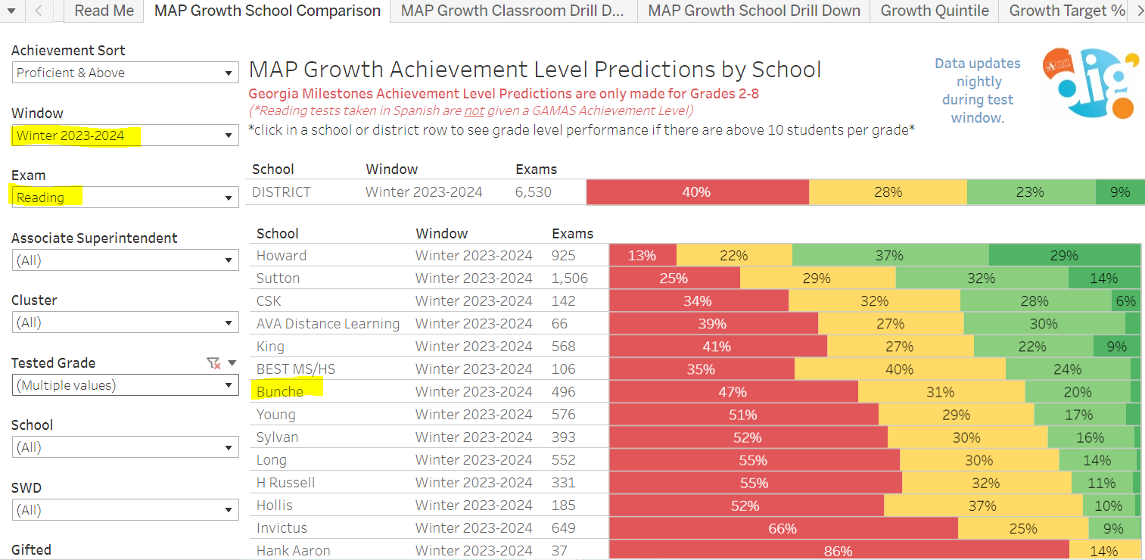
Winter 2023 MAP Results: READING
Literacy Goal to grow by 5% (from 18.5% to 23.5%)
WINTER
Proficient & Above= 22%
Fall Results= 21% Proficient & Above
GROWTH!

Slide 15
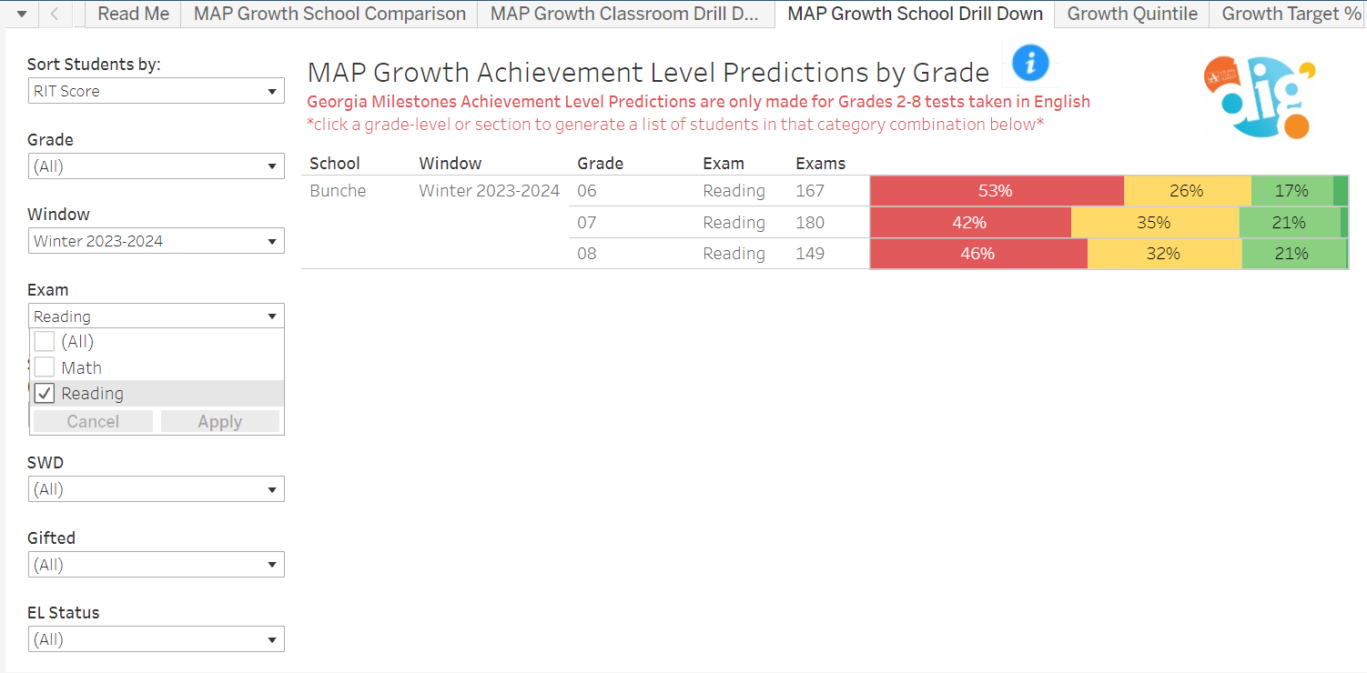
Winter 2023 MAP Results: READING

Slide 16
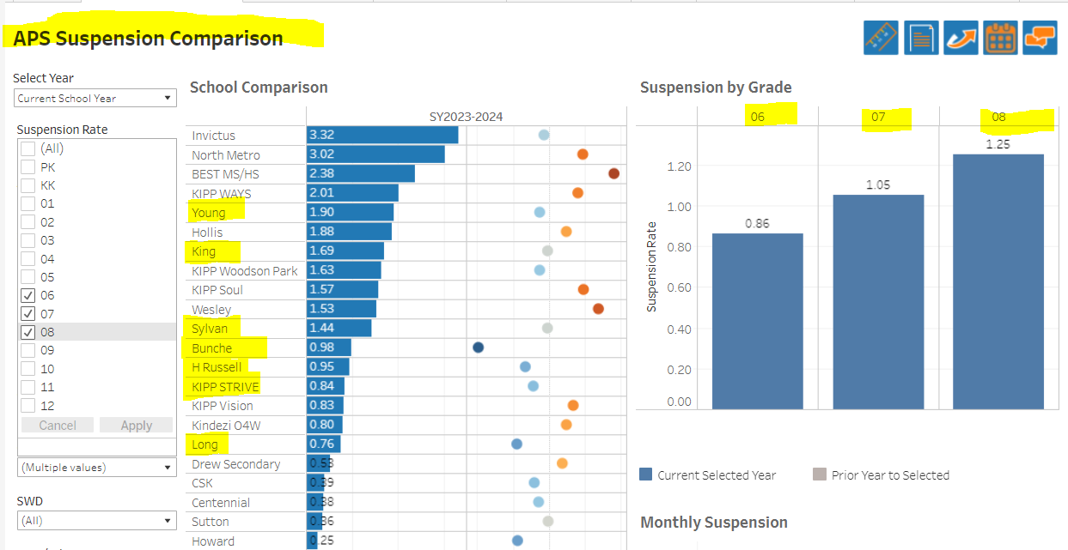
Behavior Data

Slide 17
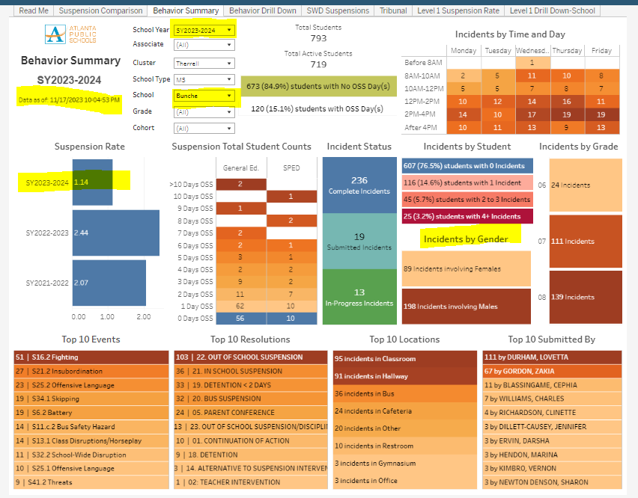
Behavior Data
Whole Child Intervention:
→To decrease the school suspension rate from 2.39% to 1.3%
→Current Suspension Rate= 1.14 %
→85% of Ss don’t have any ISS/OSS
More incidents…
Involve fighting/ insubordination
involve male students
In the class and hallway
Beginning at noon
Occur in 7th and 8th grade
→Next Steps….

Slide 18
Discussion: Data Protocol
What do you notice?
What are your wonderings?
What additional questions do you have?
FOR ACTION:
Click on the link below to add your notices, wonderings, additional questions and suggestions for next steps for the data included in slides 7-13. I’ve included some of the comments included from Tuesday’s School Improvement Team Meeting.
SIT meeting wonderings 112823.docx

Slide 19
Strategic Plan Updates

Slide 20
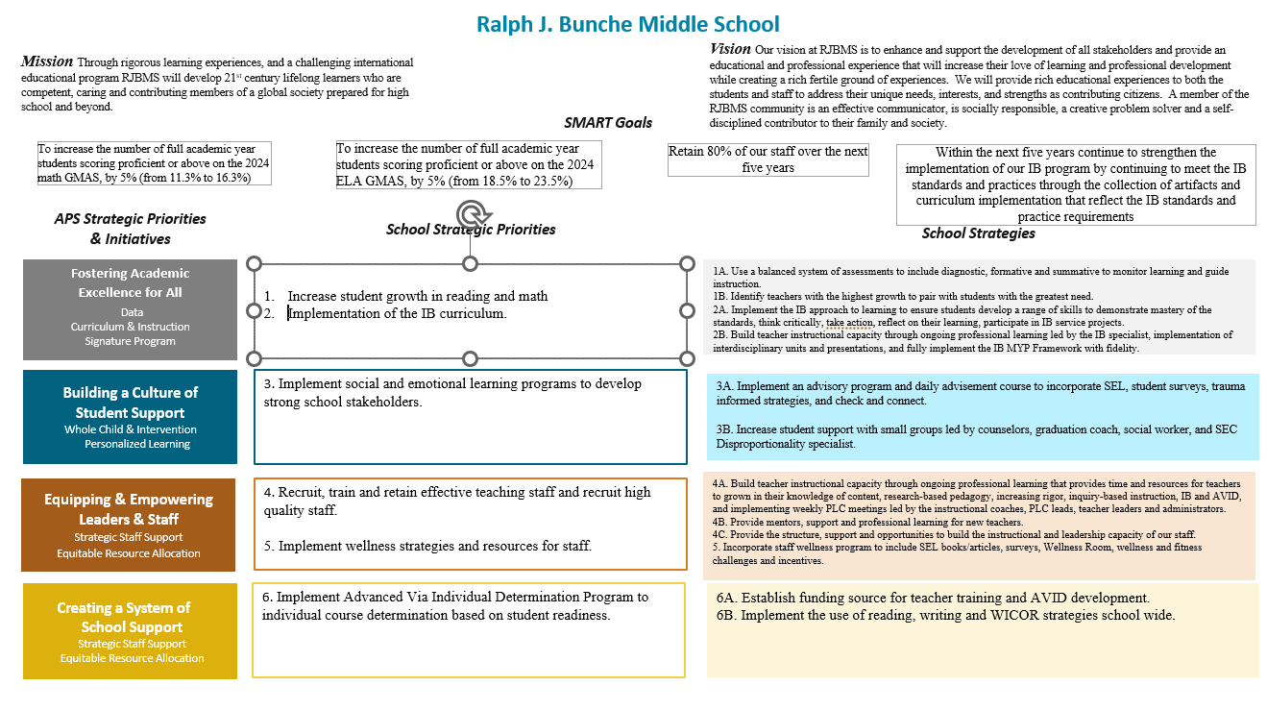
Our Strategic Plan

Slide 21
Action on the Updated Strategic Plan
The GO Team needs to TAKE ACTION (vote) on its updated Strategic Plan. After the motion and a second, the GO Team may have additional discussion. Once discussion is concluded, the GO Team will vote.

Slide 22
Preparing for Budget Development

Slide 23
Discussion
Strategic Plan Priority Ranking
In preparation for the 2024-2025 Budget Development (January–March 2024), the GO Team needs to rank its Strategic Plan Priorities. Use the next slide to capture the priority ranking.

Slide 24
Strategic Plan
Priority Ranking
Insert the school’s priorities from Higher to Lower
Higher
Increase student growth in reading and math
Implementation of the IB curriculum.
3. Implement social and emotional learning programs to develop strong
school stakeholders.
4. Recruit, train and retain effective teaching staff and recruit high quality
staff.
5. Implement wellness strategies and resources for staff.
6. Implement Advanced Via Individual Determination Program to
individual course determination based on student readiness.
Lower

Slide 25
Action on the Strategic Plan Priorities
The GO Team needs to TAKE ACTION (vote) on its ranked Strategic Plan Priorities. After the motion and a second, the GO Team may have additional discussion. Once discussion is concluded, the GO Team will vote.

Slide 26
Where we’re going
At our next meeting we will begin the discussion of the 2024-2025 budget.
Let me or the Chair know of any additional information you need for our future discussion.

Slide 27
Next GOTeam Meeting: Monday, December 11, 2023 5-6 PM via Zoom To VOTE on Strategic Plan and Rankings

